Slide 1



LAYOUT

Slide 2
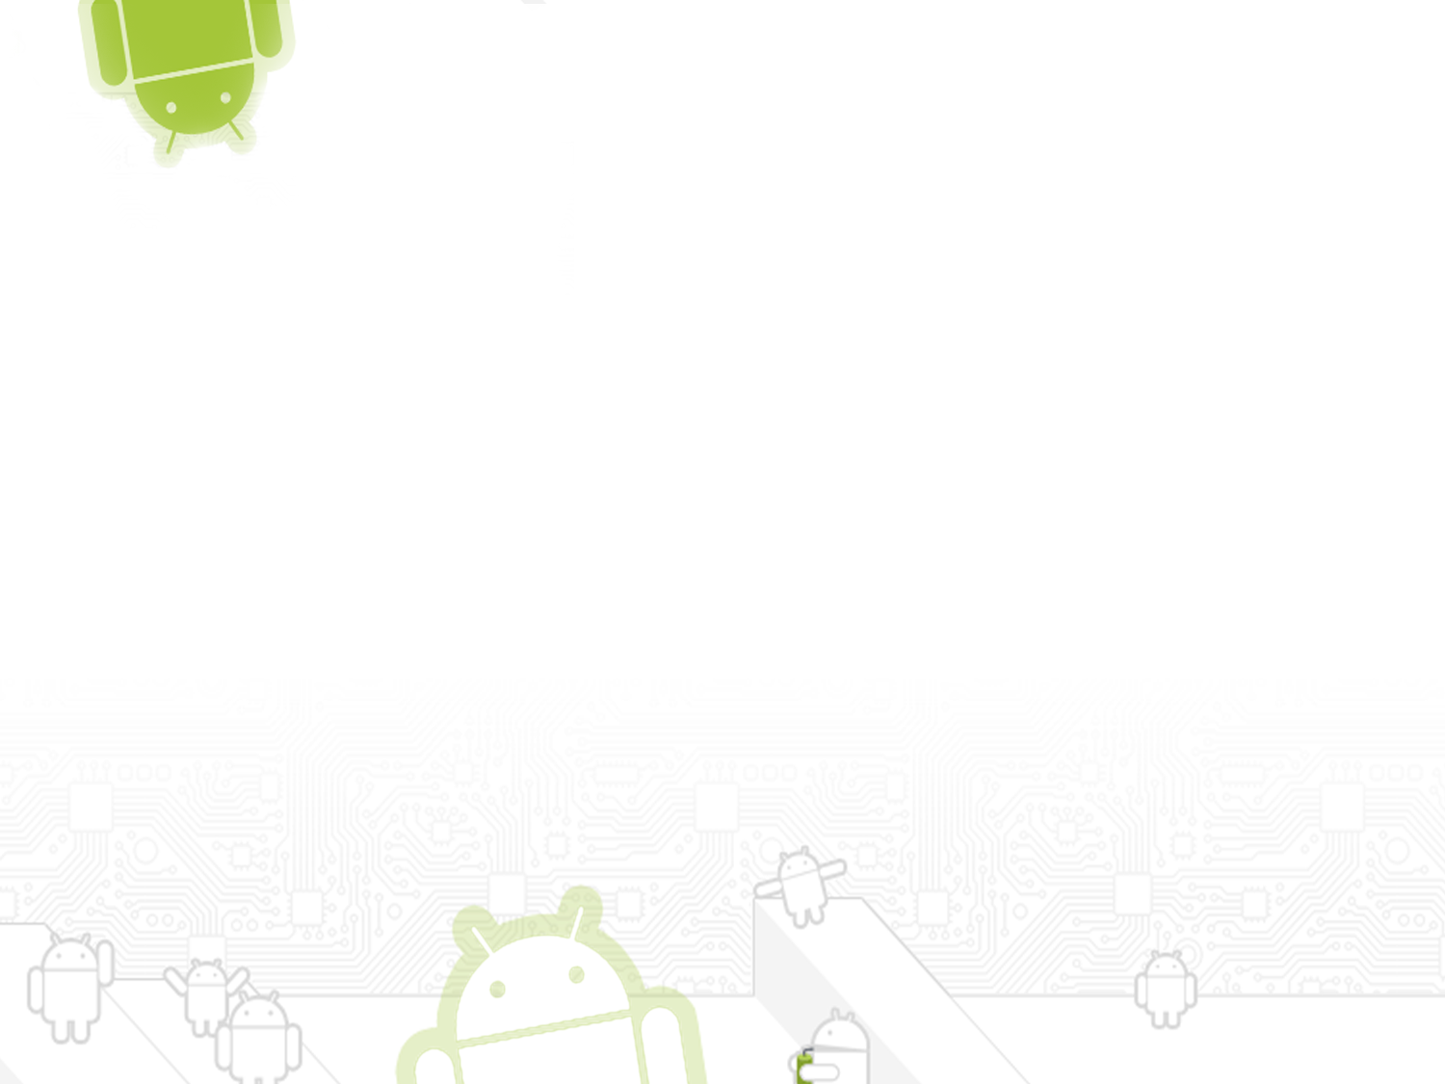
CONTENTS
What Is a Layout?
Using Android Studio to Design Layout Resources
Defining an XML Layout Resource
Frame Layout
Linear Layout
Relative Layout

Slide 3

What Is a Layout?
A type of resource that defines what is drawn on the screen. Layout resources are stored as XML files in the /res/layout resource directory for the application.
A type of View class whose primary purpose is to organize other controls. These layout classes are used to display child controls, such as text controls or buttons or images on the screen.

Slide 4

Using Android Studio to
Design Layout Resources
A layout resource defines the architecture for the UI in an Activity or a component of a UI.
Visual elements are built from:-
  ViewGroup: These are the different layouts which connect other ViewGroups and other widgets (LinearLayout, RelativeLayout,Frame Layout)
  Views are the widgets with which the user interacts (eg:Button).
  The Layout view allows you to preview how the controls will appear on various screens
  The XML view shows you the XML definition of the resource

Slide 5
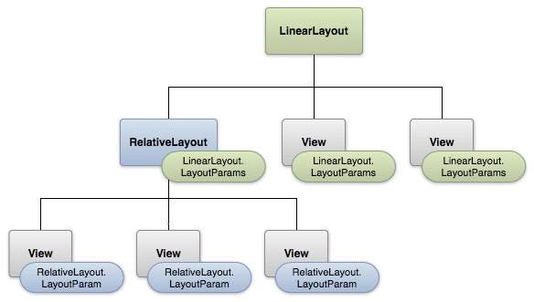
Android Layouts (Illustration)

Slide 6
Application Components (Layout)
Using a LinearLayout, child widgets are aligned horizontally or vertically
Using a RelativeLayout child widgets are aligned relative to each other or the parent window
The FrameLayout is a placeholder on screen that you can use to display a single view.
The TableLayout is a view that groups views into rows and columns.
The AbsoluteLayout enables you to specify the exact location of its children.
The GridLayout places its children in Rectangular view.

Slide 7
Layout Attributes
Every layout has a set of attributes which define the visual properties of that layout.
android:id:-This is the ID which uniquely identifies the view.
android:layout_width:-This is the width of the layout.
android:layout_height:-This is the height of the layout
android:layout_marginTop:-This is the extra space on the top side of the layout.
android:layout_marginBottom:-This is the extra space on the bottom side of the layout.
android:layout_marginLeft:-This is the extra space on the left side of the layout
android:layout_marginRight:-This is the extra space on the right side of the layout.

Slide 8
Layout Attributes
android:layout_gravity:-This specifies how child Views are positioned.id:
android:layout_weight:-This specifies how much of the extra space in the layout should be allocated to the View.
android:layout_x:-This specifies the x-coordinate of the layout.
android:layout_y:-This specifies the y-coordinate of the layout.
android:paddingLeft:-This is the left padding filled for the layout.
android:paddingRight:-This is the right padding filled for the layout.
android:paddingTop:-This is the top padding filled for the layout.
android:paddingBottom:-This is the bottom padding filled for the layout.

Slide 9
Defining an XML Layout Resource
The most convenient and maintainable way to design application user interfaces is by creating XML layout resources.
This method greatly simplifies the UI design process.
Creates a potential distinction between UI designers and developers
Developers can still alter the content of a screen programmatically when necessary.
Common practice to create an XML layout resource for each screen in your application

Slide 10
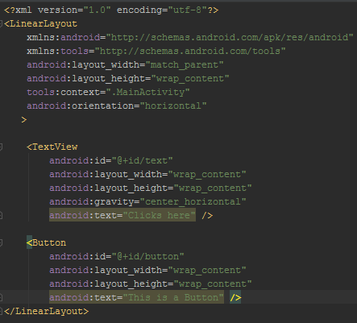

Slide 11
Frame Layout
Frame layouts are one of the simplest and most efficient types of layouts
Generally used to display only one view, or views which overlap.
Frame layouts are very simple
Makes them very efficient
A child view within a frame layout
Drawn relative to the top left-hand corner of the screen.
The first view added to the frame layout will display on the bottom of the stack
The last view added will display on top.

Slide 12

Example.....
  An ImageView with a picture of a lake.
  A TextView with some text to display towards the top of the screen.
  A TextView with some text to display towards the bottom of the screen.

Slide 13
XML Layout Resource
  The most convenient and maintainable way to design application user interfaces is by creating XML layout resources.
  This method greatly simplifies the UI design process.
  XML layout resources must be stored in the /res/layout project directory hierarchy.

Slide 14
<?xml version="1.0" encoding="utf-8"?> <FrameLayout xmlns:android="http://schemas.android.com/apk/res/android" android:layout_width="fill_parent" android:layout_height="fill_parent"> <ImageView android:id="@+id/ImageView01" android:layout_height="fill_parent" android:layout_width="fill_parent" android:src="@drawable/lake" android:scaleType="matrix"></ImageView> <TextView android:layout_width="fill_parent" android:layout_height="wrap_content" android:textColor="#000" android:textSize="40dp" android:text="@string/top_text" /> <TextView android:layout_width="fill_parent" android:layout_height="wrap_content" android:text="@string/bottom_text" android:layout_gravity="bottom" android:gravity="right" android:textColor="#fff" android:textSize="50dp" /> </FrameLayout>

Slide 15
Linear Layout
The simplest and most common types of layouts used by Android developers to organize controls within their user interfaces.
The linear layout works much as its name implies
Organizes controls linearly in either a vertical or horizontal fashion.
The layout’s orientation is set to vertical
All child controls within it are organized in a single column.

Slide 16
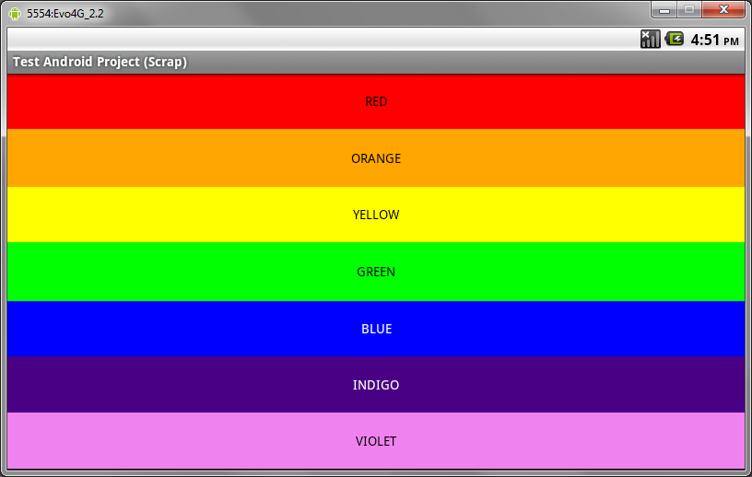
figure shows a linear layout with seven TextView controls.
This linear layout’s orientation is set to vertical,
Causing each of the TextView controls to display in a single column.
Each TextView control has its text attribute set to a colour, That same colour set as the background for the control;
Each control is stretched the width of the screen by setting the controls’ layout_width attribute to fill_parent.

Slide 17
XML Layout Resource
<?xml version="1.0" encoding="utf-8"?> <LinearLayout xmlns:android="http://schemas.android.com/apk/res/android" android:layout_width="fill_parent" android:layout_height="fill_parent" android:orientation="vertical"> <TextView android:text="RED" android:id="@+id/TextView01" android:layout_height="wrap_content" android:background="#f00" android:layout_width="fill_parent" android:layout_weight=".14" android:gravity="center" android:textColor="#000"></TextView> <TextView android:text="ORANGE" android:id="@+id/TextView02" android:layout_height="wrap_content" android:layout_width="fill_parent" android:layout_weight=".15" android:background="#ffa500" android:gravity="center" android:textColor="#000"></TextView> <TextView android:text="YELLOW" android:id="@+id/TextView03" android:layout_height="wrap_content" android:layout_width="fill_parent" android:layout_weight=".14" android:background="#ffff00" android:gravity="center" android:textColor="#000"></TextView> | <TextView android:text="GREEN" android:id="@+id/TextView04" android:layout_height="wrap_content" android:layout_width="fill_parent" android:layout_weight=".15" android:background="#0f0" android:gravity="center" android:textColor="#000"></TextView> <TextView android:text="BLUE" android:id="@+id/TextView05" android:layout_height="wrap_content" android:layout_width="fill_parent" android:layout_weight=".14" android:background="#00f" android:gravity="center" android:textColor="#fff"></TextView> <TextView android:text="INDIGO" android:id="@+id/TextView06" android:layout_height="wrap_content" android:layout_width="fill_parent" android:layout_weight=".14" android:background="#4b0082" android:gravity="center" android:textColor="#fff"></TextView> <TextView android:text="VIOLET" android:id="@+id/TextView07" android:layout_height="wrap_content" android:layout_width="fill_parent" android:layout_weight=".14" android:background="#ee82ee" android:gravity="center" android:textColor="#000"></TextView> </LinearLayout>

Slide 18
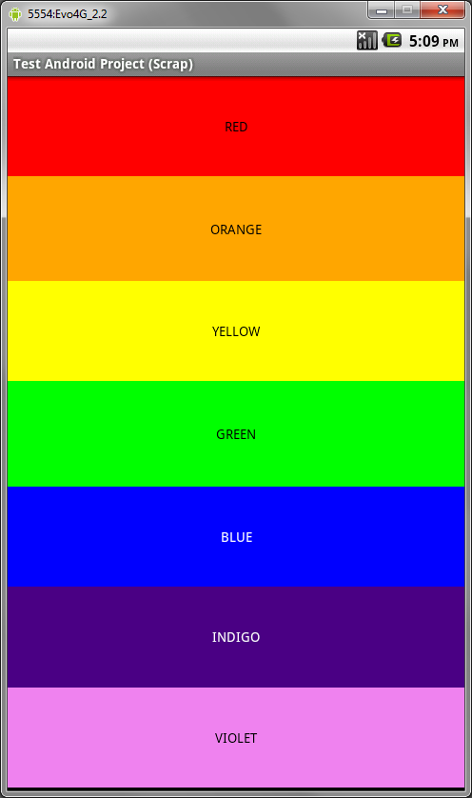
The following two figures show what this layout might look like on a device in both portrait and landscape modes:

Slide 19

Linear Layout
Properties and attributes
Most important attributes you’ll use with linear layouts include:
  The orientation attribute (required), which can be set to vertical or horizontal (class: LinearLayout)
  The gravity attribute (optional), which controls how all child controls are aligned and displayed within the linear layout (class: LinearLayout)
  The layout_weight attribute (optional, applied to each child control) specifies each child control’s relative importance within the parent linear layout (class: LinearLayout.LayoutParams)
Also, general ViewGroup-style attributes apply to linear layouts. These include:
  Generic Layout Parameters such as layout_height (required) and layout_width (required) (class: ViewGroup.LayoutParams)
  Margin Layout Parameters such as margin_top, margin_left, margin_right and margin_bottom (class: ViewGroup. MarginLayoutParams)
  Layout Parameters such as layout_height and layout_width (class: ViewGroup.LayoutParams)

Slide 20
Weighing Child Controls
Most of the linear layout attributes are pretty self explanatory.
The layout_weight attribute deserves a bit of extra discussion.
This attribute applies to its child controls
The weight values themselves should be numbers (eg .50, .25, .10, .10, .05,),
The total if you sum the weight values of all children equals 1 (100%).
The weight of a child controls how much “importance” or “space” it’s given within its parent linear layout.

Slide 21
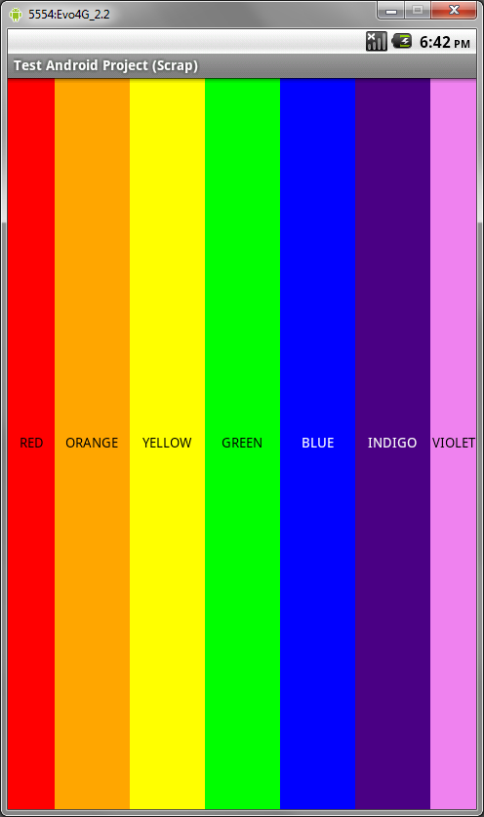
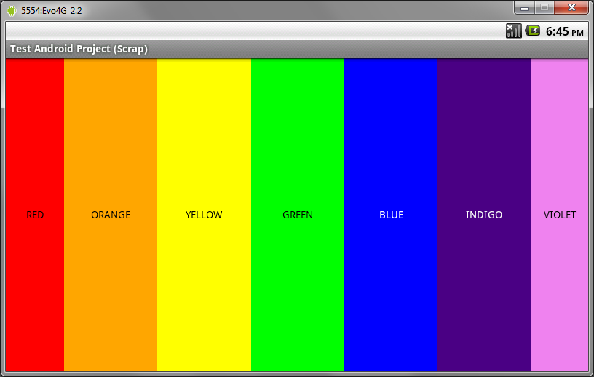
Example....

Slide 22
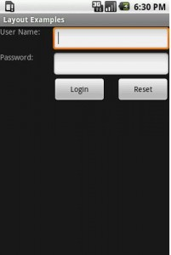

Relative Layout
This layout is flexible layout of all.
This layout as name suggest allow placing components relative to other component or layout.

Slide 23

Questions?

Slide 24
Thank you

